Slide 1
Ecuaciones Algebraicas lineales

Slide 2
An equation of the form ax+by+c=0 or equivalently ax+by=-c is called a linear equation in x and y variables.
ax+by+cz=d is a linear equation in three variables, x, y, and z.
Thus, a linear equation in n variables is
a₁x₁+a₂x₂+ … +a_{n}x_{n} = b
A solution of such an equation consists of real numbers c₁, c₂, c₃, … , c_{n}. If you need to work more than one linear equations, a system of linear equations must be solved simultaneously.

Slide 3
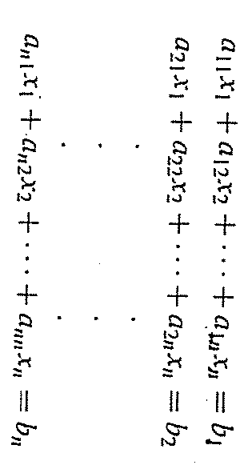
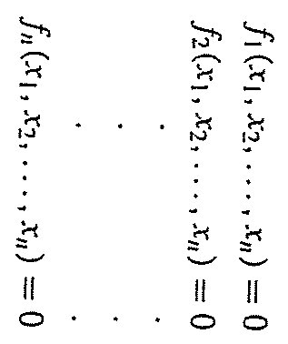
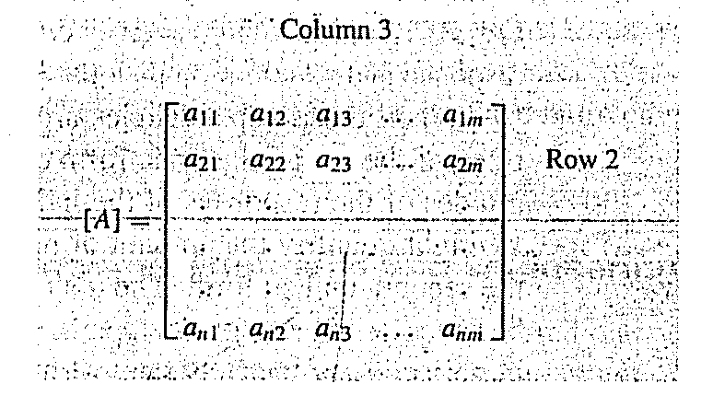
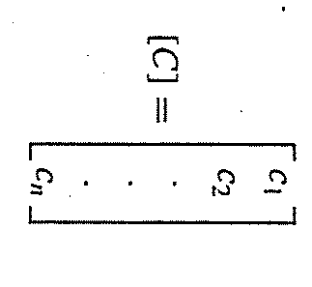
Matrices
aij = elementos de una matriz
i=número del renglón
j=número de la columna
Vector columna
Vector renglón

Slide 4
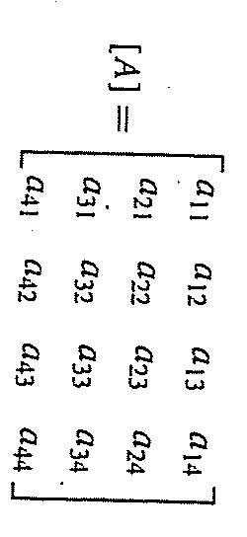
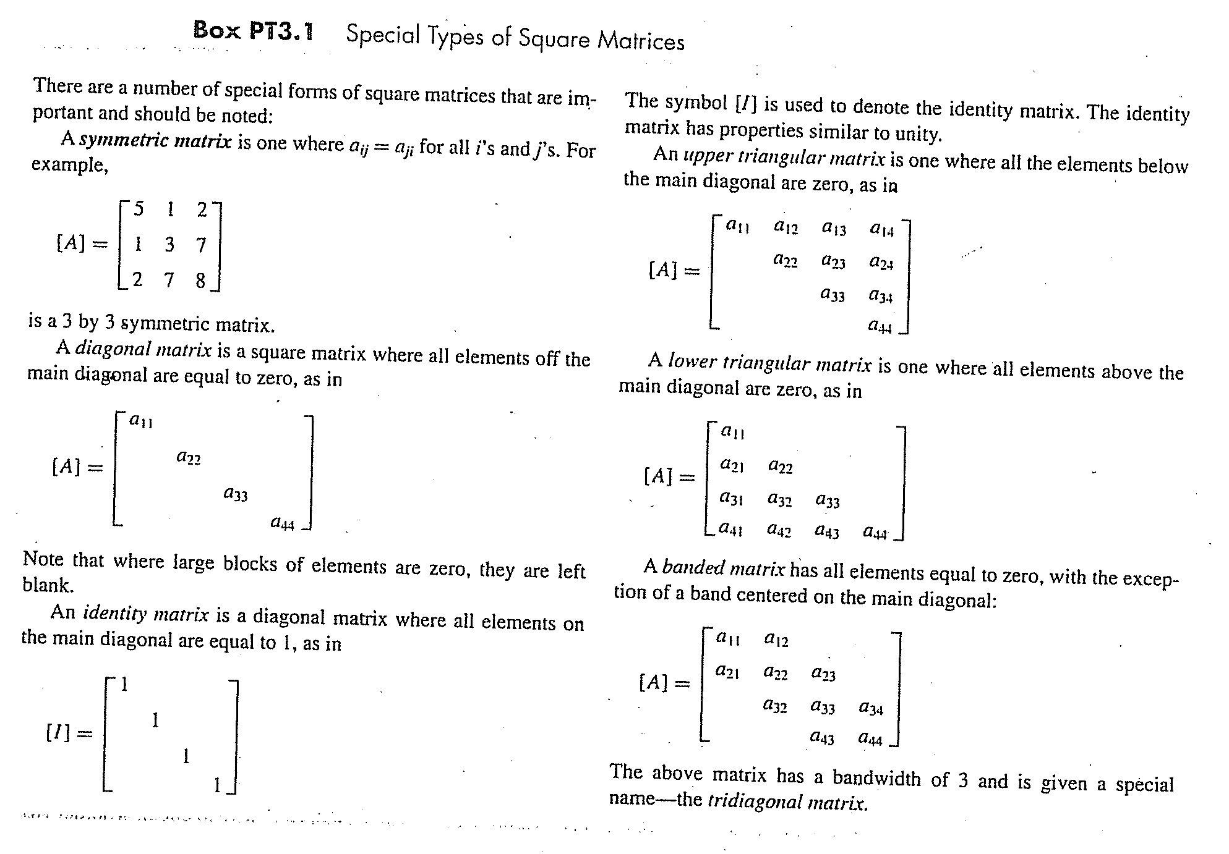
Matriz cuadrada m=n
Número de
ecuaciones
Diagonal principal
Número de incóngnitas

Slide 5
Reglas de operaciones con matrices

Slide 6
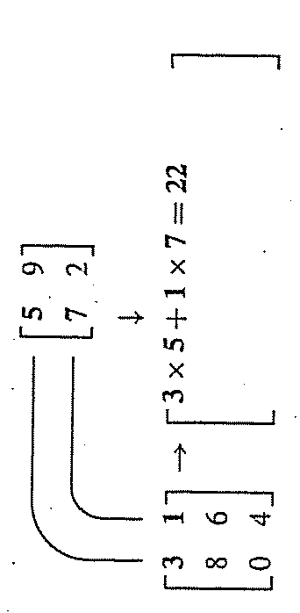
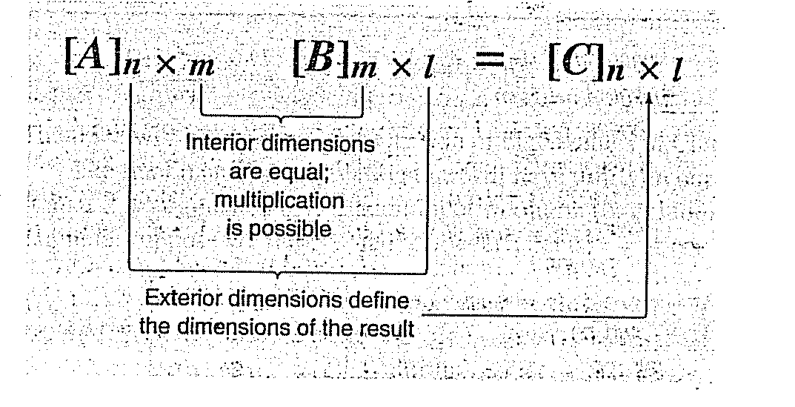

Slide 7
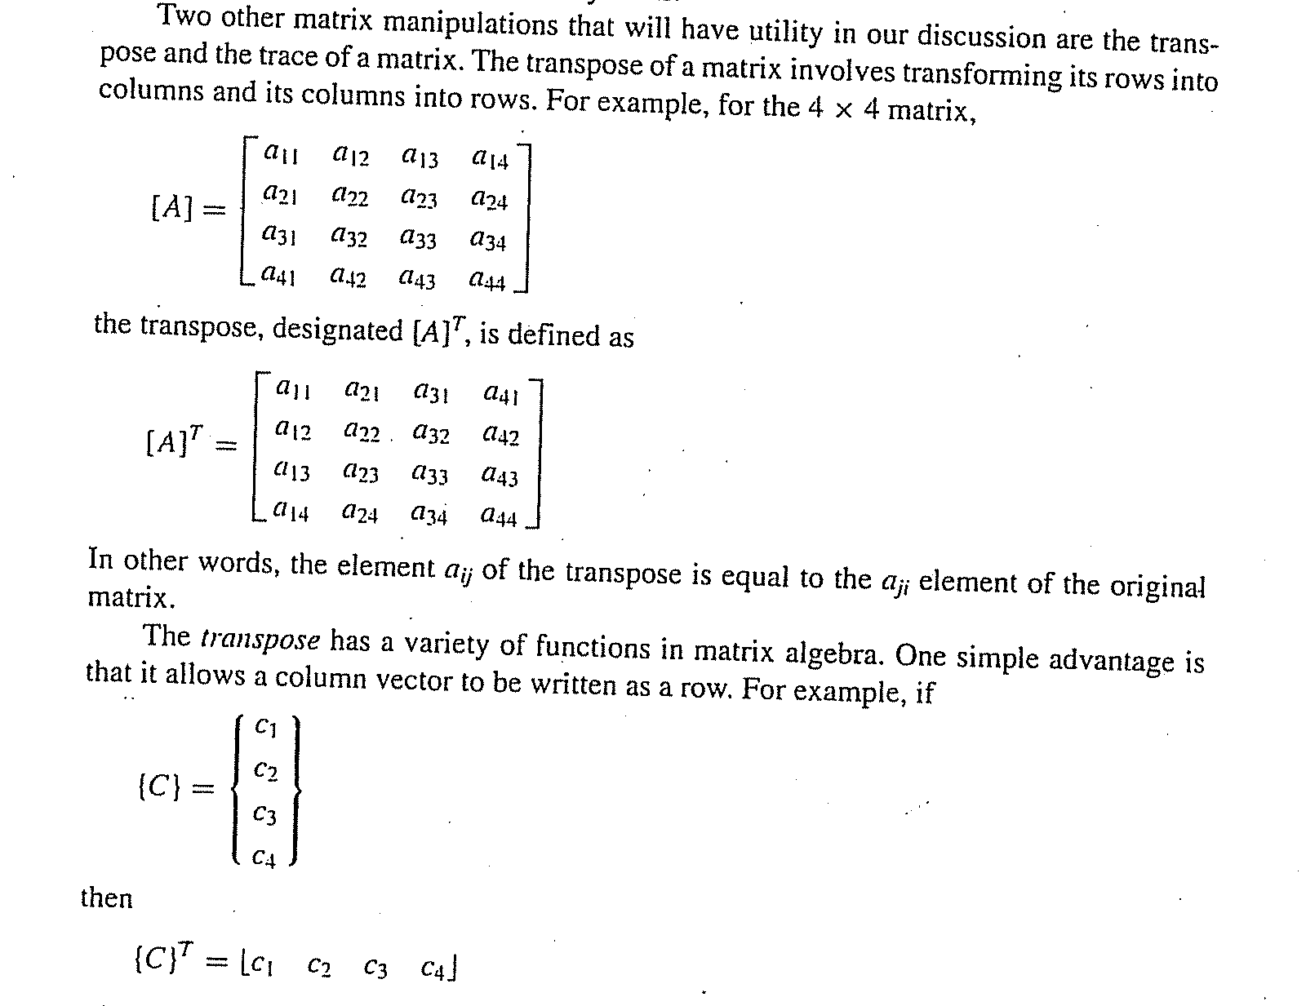

Slide 8
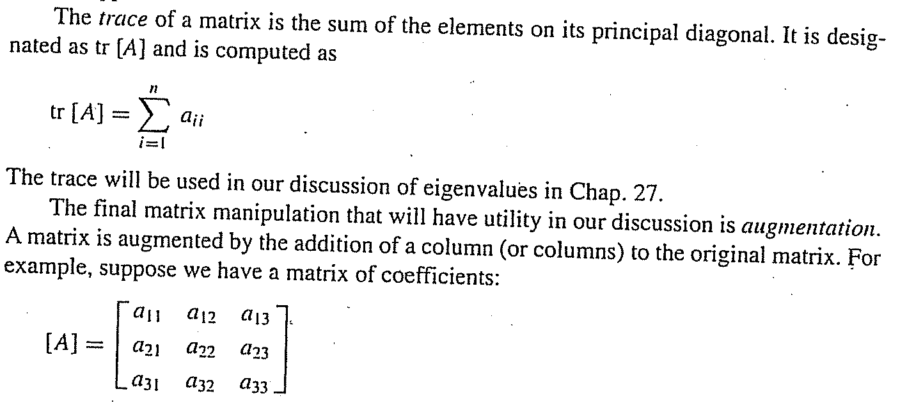

Slide 9
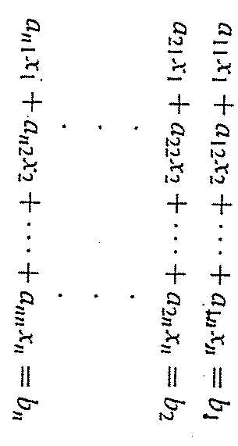
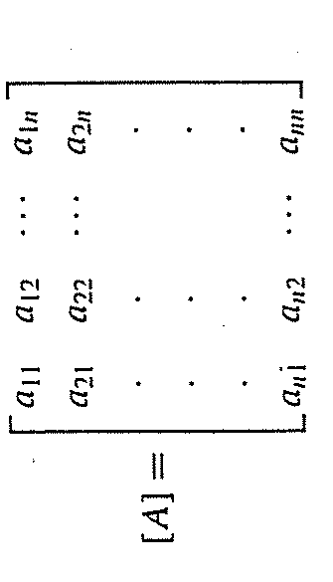
Representación de ecuaciones algebraicas lineales en forma matricial
Solving for X

Slide 10
Noncomputer Methods for Solving Systems of Equations
For small number of equations (n ≤ 3) linear equations can be solved readily by simple techniques such as “method of elimination.”
Linear algebra provides the tools to solve such systems of linear equations.
Nowadays, easy access to computers makes the solution of large sets of linear algebraic equations possible and practical.

Slide 11
Gauss Elimination Chapter 9
Solving Small Numbers of Equations
There are many ways to solve a system of linear equations:
Graphical method
Cramer’s rule
Method of elimination
Computer methods
For n ≤ 3

Slide 12
Graphical Method
For two equations:
Solve both equations for x_{2:}

Slide 13
Plot x₂ vs. x₁ on rectilinear paper, the intersection of the lines present the solution.
Fig. 9.1

Slide 14
Graphical Method
Or equate and solve for x₁

Slide 15
Figure 9.2
No solution
Infinite solutions
Ill-conditioned
(Slopes are too close)

Slide 16
Determinants and Cramer’s Rule
Determinant can be illustrated for a set of three equations:
Where A is the coefficient matrix:

Slide 17
Assuming all matrices are square matrices, there is a number associated with each square matrix A called the determinant, D, of A. (D=det (A)). If [A] is order 1, then [A] has one element:
A=[a₁₁]
D=a₁₁
For a square matrix of order 2, A=
the determinant is D= a₁₁ a₂₂-a₂₁ a₁₂
a₁₁ a₁₂
a₂₁ a₂₂

Slide 18
For a square matrix of order 3, the minor of an element a_{ij} is the determinant of the matrix of order 2 by deleting row i and column j of A.

Slide 20
Cramer’s rule expresses the solution of a systems of linear equations in terms of ratios of determinants of the array of coefficients of the equations. For example, x₁ would be computed as:

Slide 21
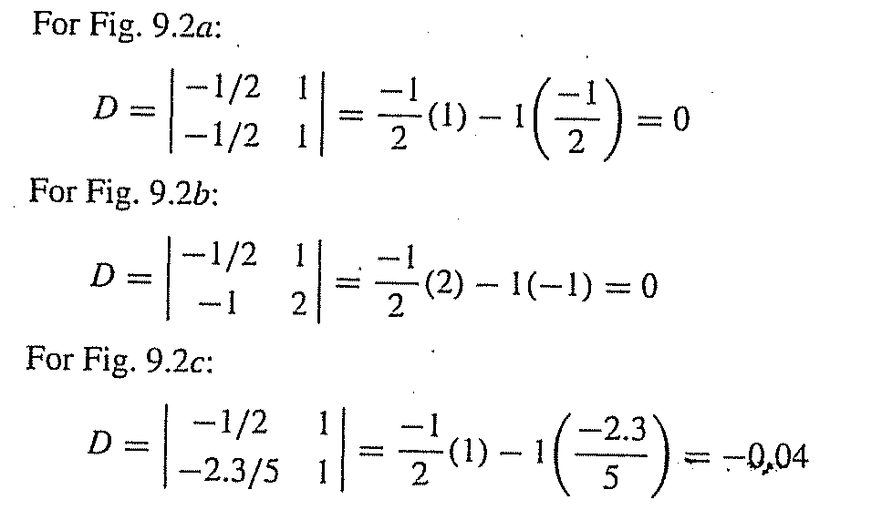

Slide 22
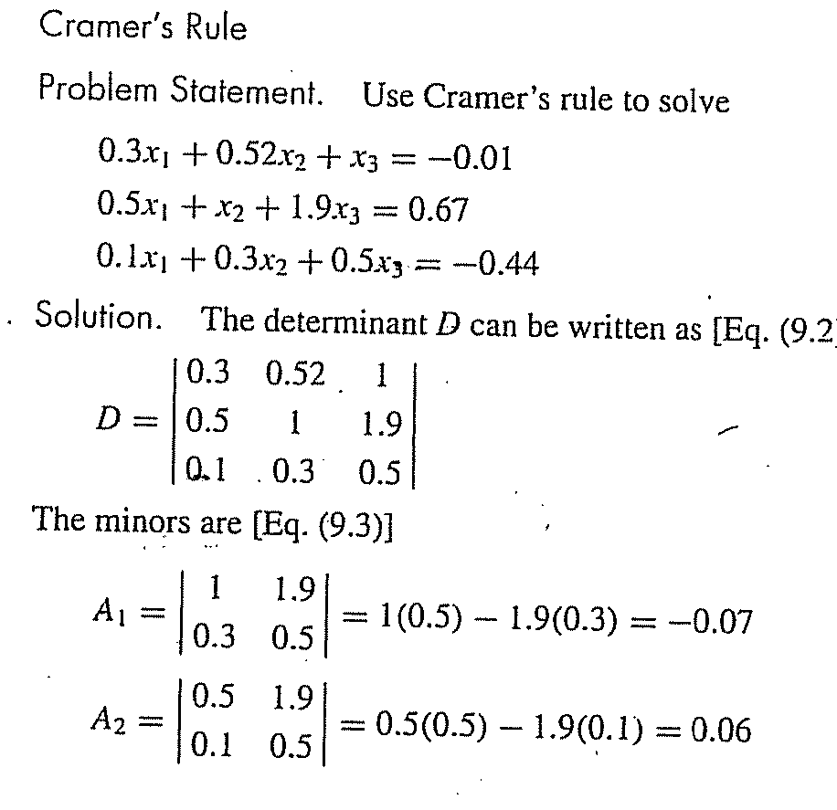
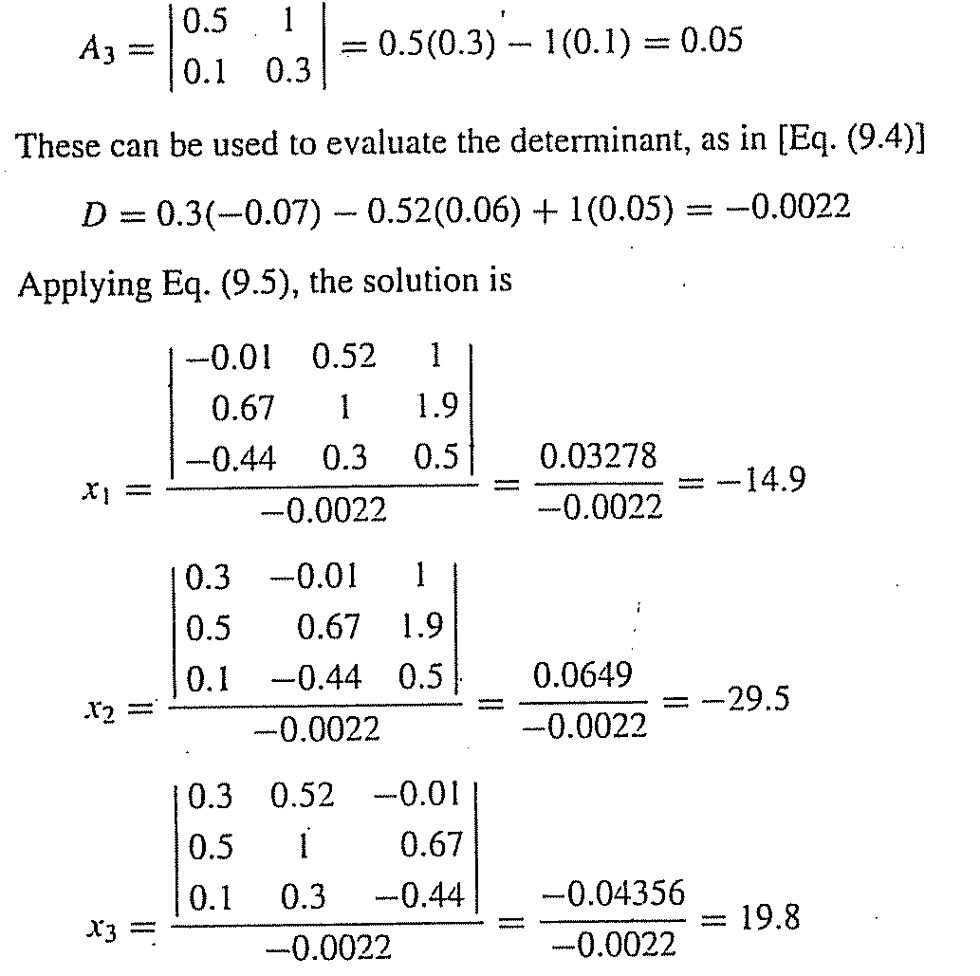

Slide 23
Method of Elimination
The basic strategy is to successively solve one of the equations of the set for one of the unknowns and to eliminate that variable from the remaining equations by substitution.
The elimination of unknowns can be extended to systems with more than two or three equations; however, the method becomes extremely tedious to solve by hand.

Slide 24
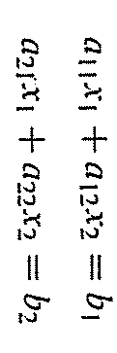
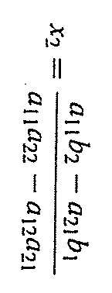
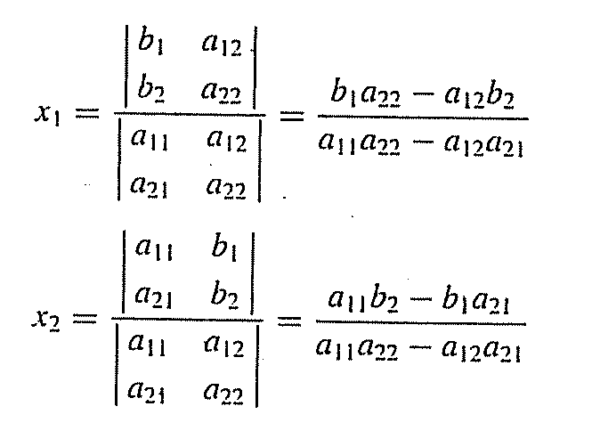
Relación con Cramer

Slide 25
Naive Gauss Elimination
Extension of method of elimination to large sets of equations by developing a systematic scheme or algorithm to eliminate unknowns and to back substitute.
As in the case of the solution of two equations, the technique for n equations consists of two phases:
Forward elimination of unknowns
Back substitution

Slide 26
Fig. 9.3

Slide 27
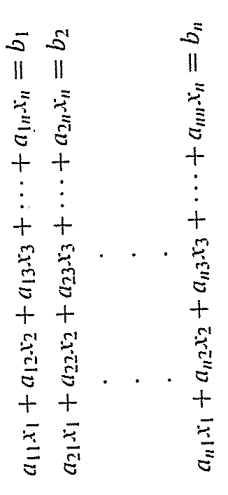
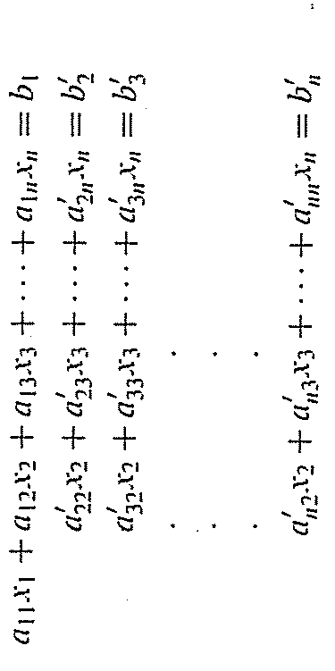
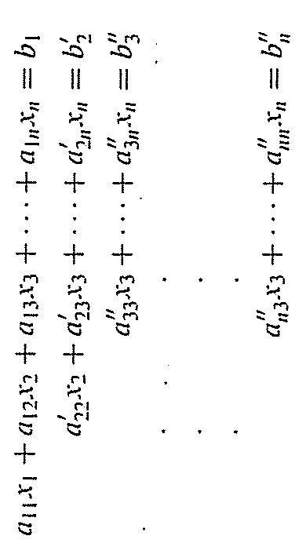
Generalizando
Elemento pivote
Multiplicando ec 1
a32’/a22’ = nuevo elemento pivote
Restando ec2 de la nueva ec1
Reescribiendo ec anterior

Slide 28
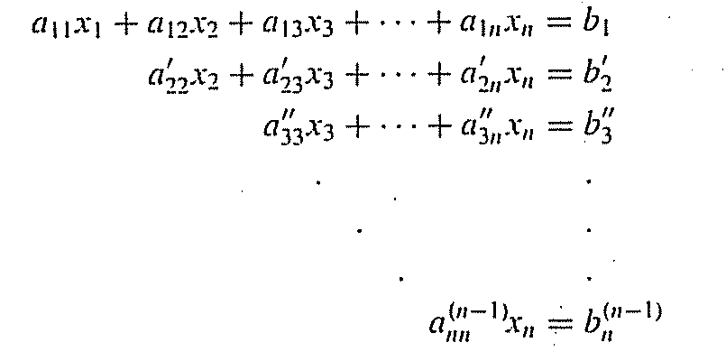
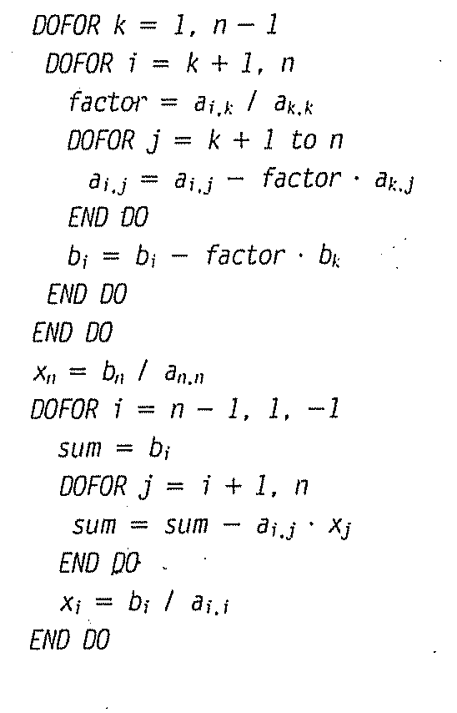

Slide 29
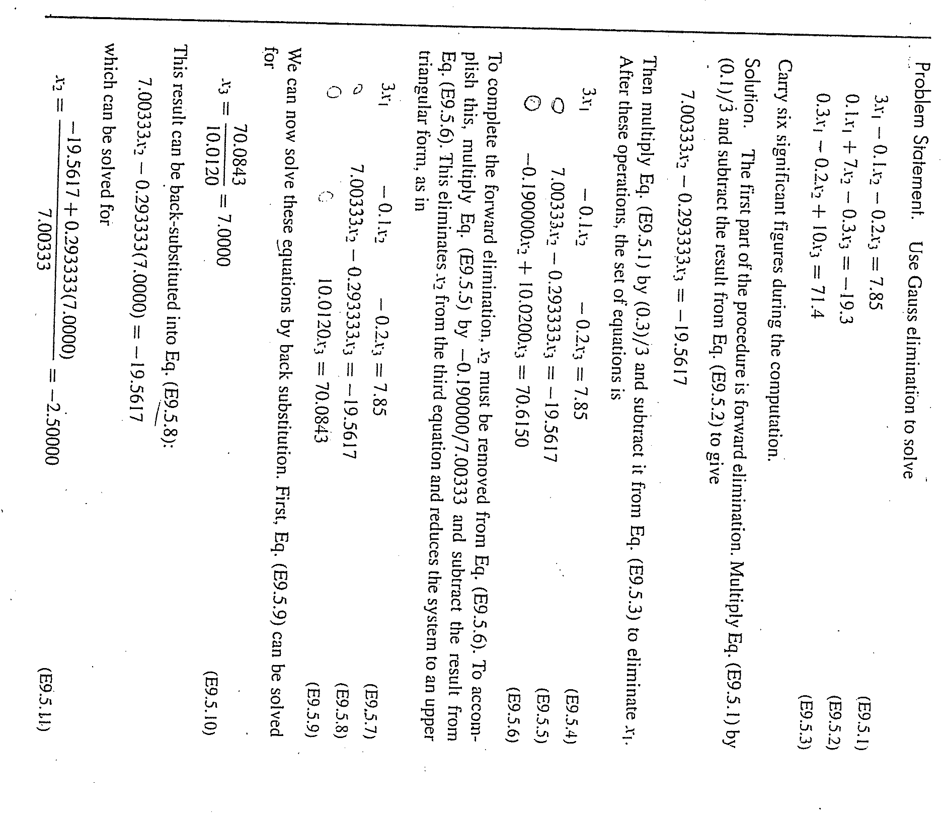

Slide 30
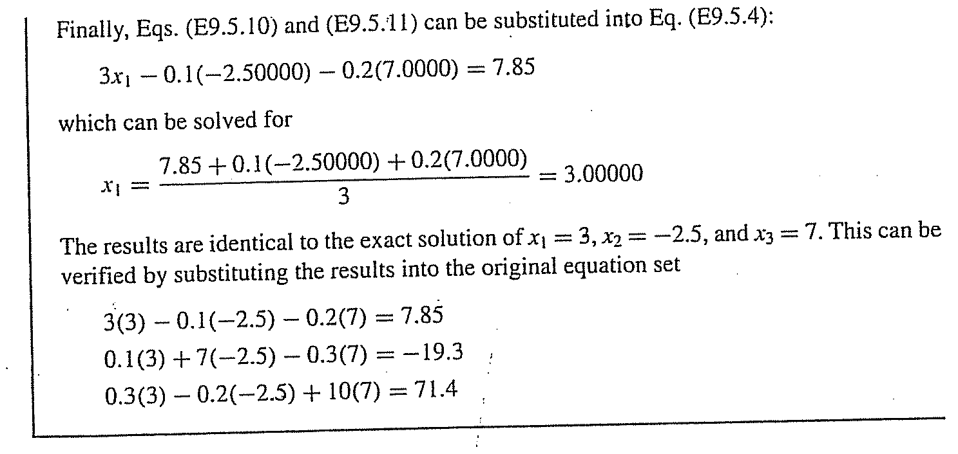

Slide 31
Pitfalls of Elimination Methods
Division by zero. It is possible that during both elimination and back-substitution phases a division by zero can occur.
Round-off errors.
Ill-conditioned systems. Systems where small changes in coefficients result in large changes in the solution. Alternatively, it happens when two or more equations are nearly identical, resulting a wide ranges of answers to approximately satisfy the equations. Since round off errors can induce small changes in the coefficients, these changes can lead to large solution errors.

Slide 32
Singular systems. When two equations are identical, we would loose one degree of freedom and be dealing with the impossible case of n-1 equations for n unknowns. For large sets of equations, it may not be obvious however. The fact that the determinant of a singular system is zero can be used and tested by computer algorithm after the elimination stage. If a zero diagonal element is created, calculation is terminated.

Slide 33
Techniques for Improving Solutions
Use of more significant figures.
Pivoting. If a pivot element is zero, normalization step leads to division by zero. The same problem may arise, when the pivot element is close to zero. Problem can be avoided:
Partial pivoting. Switching the rows so that the largest element is the pivot element.
Complete pivoting. Searching for the largest element in all rows and columns then switching.

Slide 34
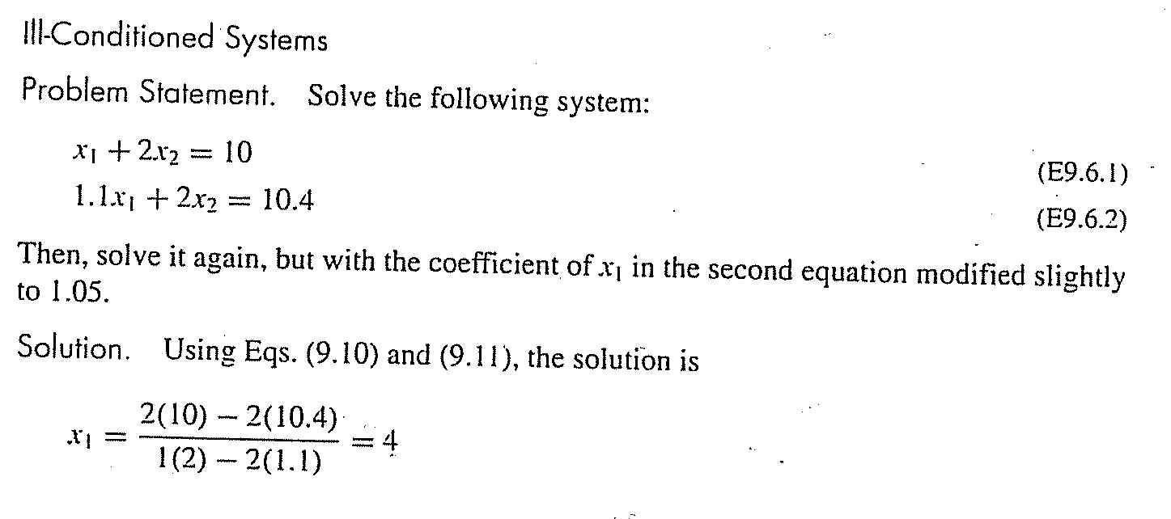
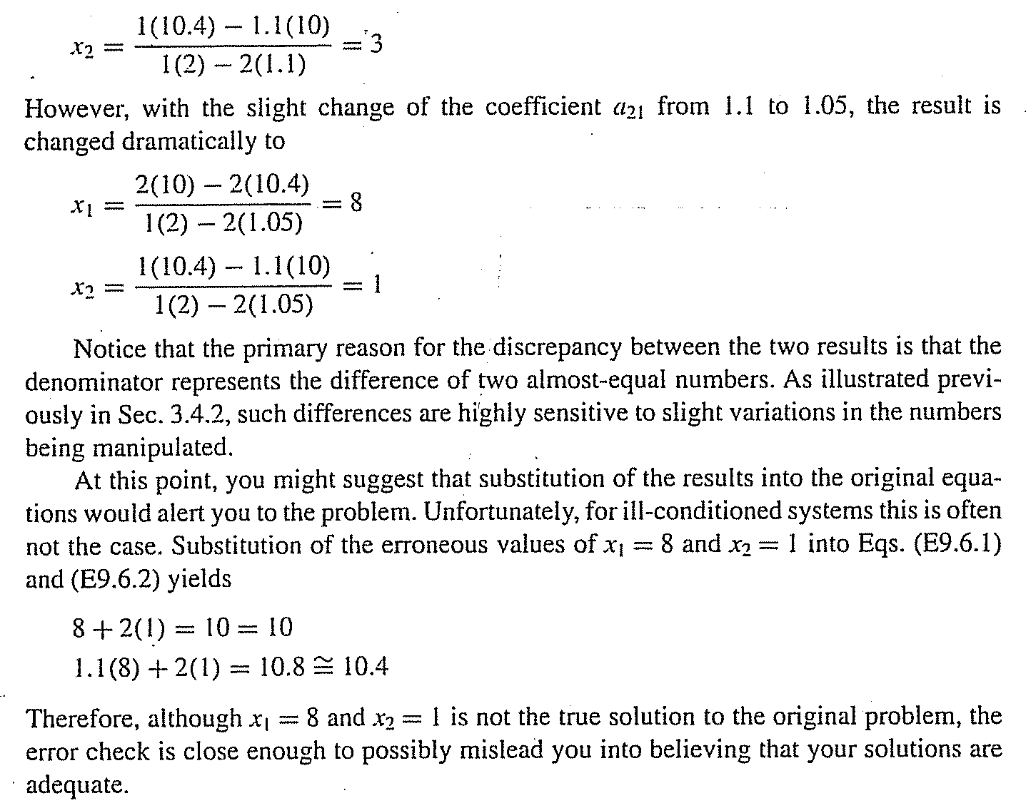
Cramer o sustituciòn

Slide 35
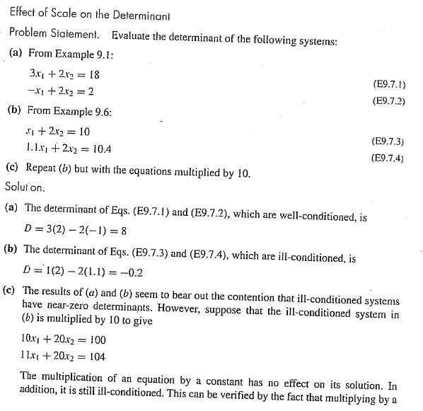

Slide 36
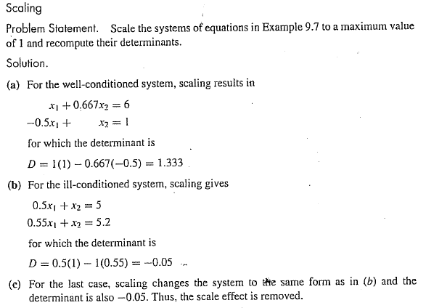

Slide 37
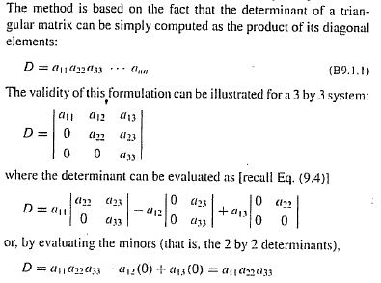
Determinant Evaluation Using Gauss Elimination

Slide 38
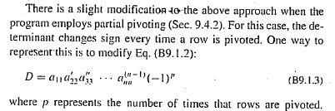

Slide 39
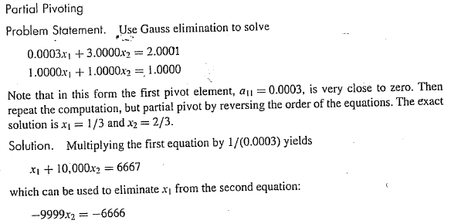
Casi cero !!!
Depende del numero de cifras significativas

Slide 40
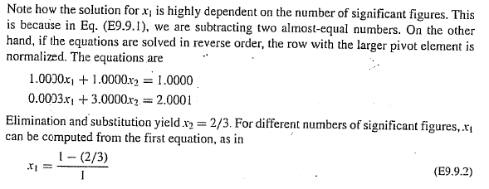
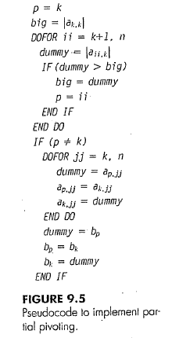

Slide 41
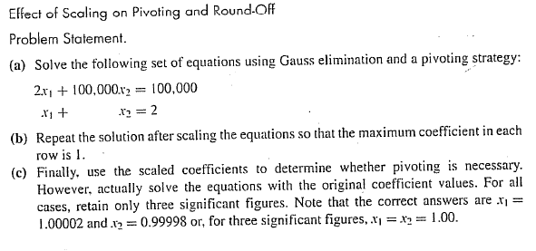
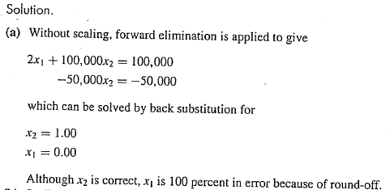
SCALING

Slide 42
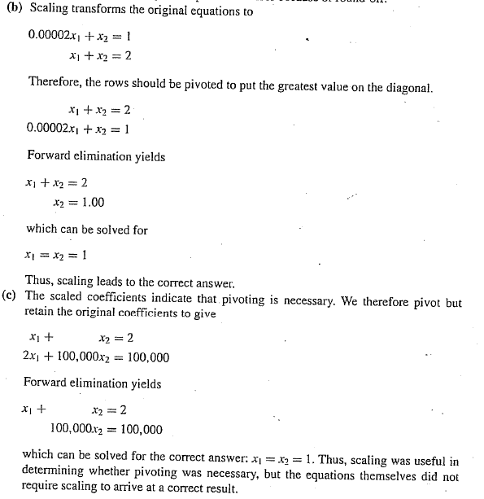

Slide 43
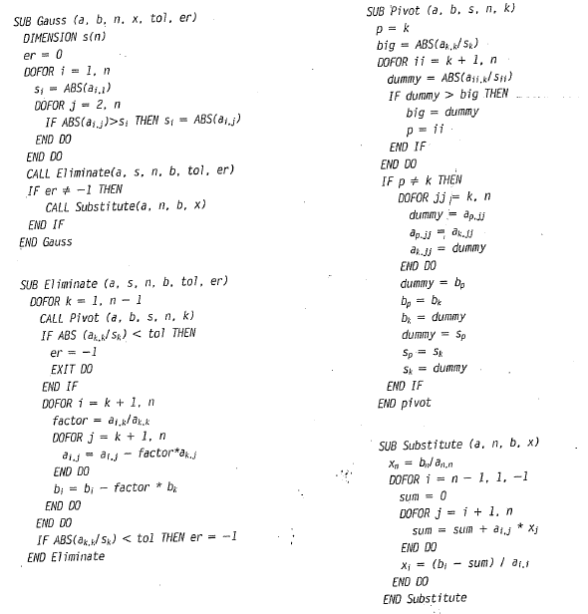

Slide 44
Gauss-Jordan
It is a variation of Gauss elimination. The major differences are:
When an unknown is eliminated, it is eliminated from all other equations rather than just the subsequent ones.
All rows are normalized by dividing them by their pivot elements.
Elimination step results in an identity matrix.
Consequently, it is not necessary to employ back substitution to obtain solution.

Slide 45
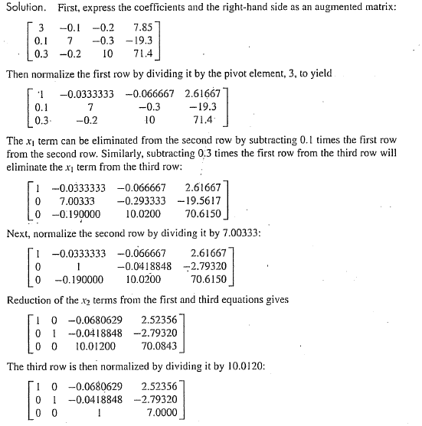

Slide 46
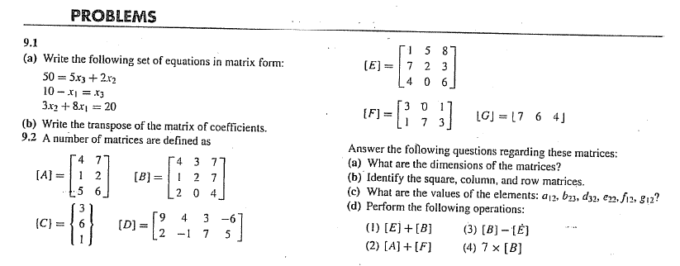

Slide 48
Descomposición LU e inversión de Matrices
[A]{X}={B}
[A]{X}-{B}=0
Gauss Elimination
[U]{X}-{D}=0

Slide 49
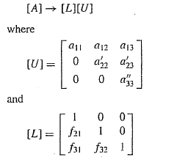
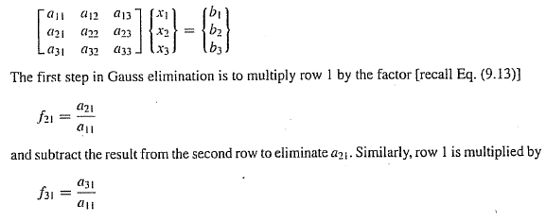
De la eliminación hacia delante de Gauss tenemos :
Finalmente

Slide 50
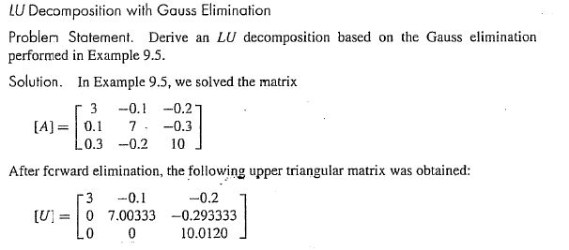
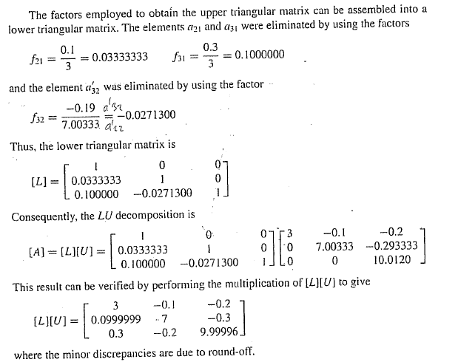
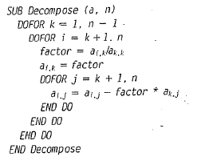

Slide 51
Encontrando ‘d’ aplicando la eliminación
hacia adelante pero solo sobre el vector ‘B’
Encontrando ‘X’ aplicando la sustitución
hacia atrás

Slide 52
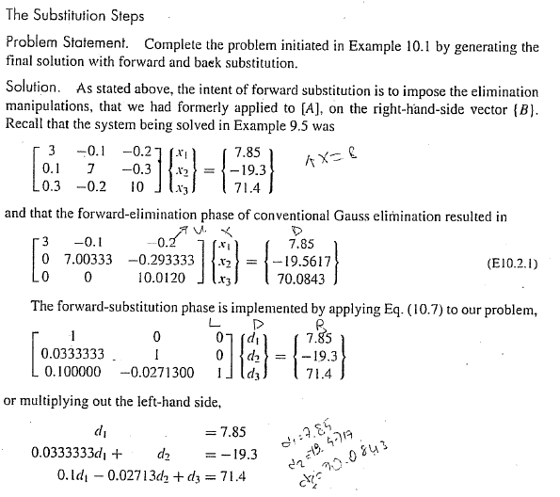

Slide 53
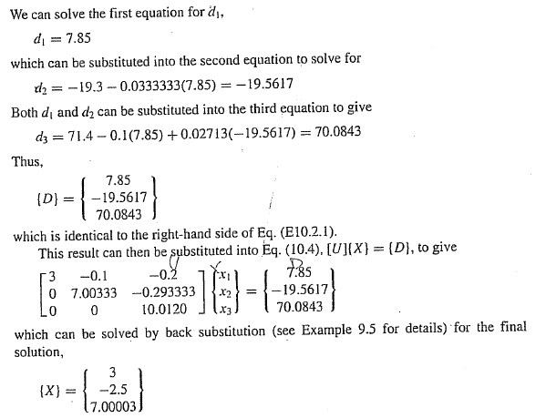

Slide 54
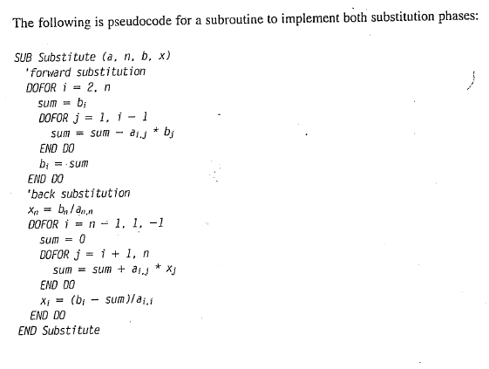

Slide 55
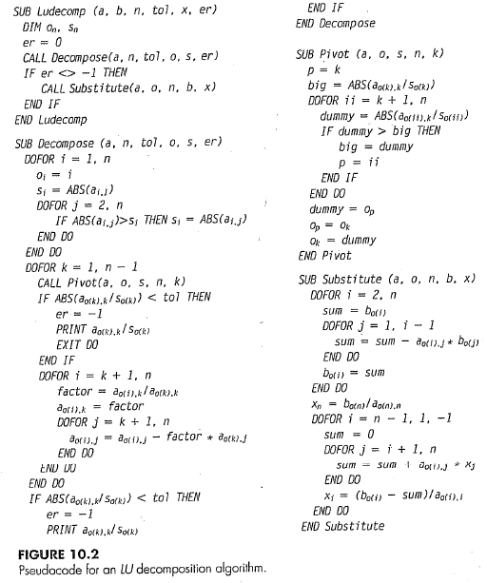

Slide 56
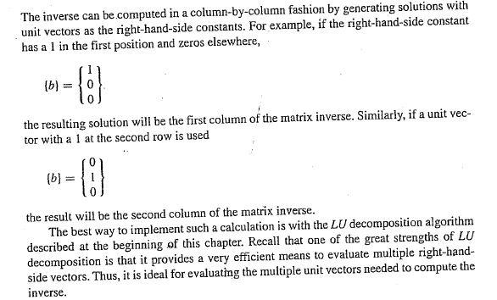
Matriz Inversa

Slide 59
Homework

